Slide 1

SHA-256 & Bitcoin Hash
Nick Cronin & Henry Liu

Slide 2
SHA-256
Secure Hash Algorithm (SHA) - a family of cryptographic hash functions
Key properties:
One Way Function: Computationally infeasible to reverse
Fixed Output Size: Always produces a 256-bit hash value
Deterministic: Same input always yields the same output
Collision Resistance: Unlikely for different inputs to produce the same hash
Notes:
Henry
SHA-256 is a cryptographic hash function that is commonly used in areas such as certificate generation, password hashing, blockchain technology, and more
Relied upon because of its key properties:
1-way, the original input message cannot be recreated from the generated hash values
The output is fixed to 256bits
It is deterministic - so the same input will generate the same hash values - you wouldn’t want the same password to generate a different password hash when trying to find its location in a database!
Collision resistance - it is highly unlikely that different inputs to produce the same hash. Small changes in the input will yield drastic output changes in this algorithm
Our project is based on this by converting an input message of 20, 30, and 40 words and creating its 256 bit hash output
This is done by splitting up the original input message into blocks
Creating the hash values for each block and then having each block build off the previous block’s created hash values

Slide 3
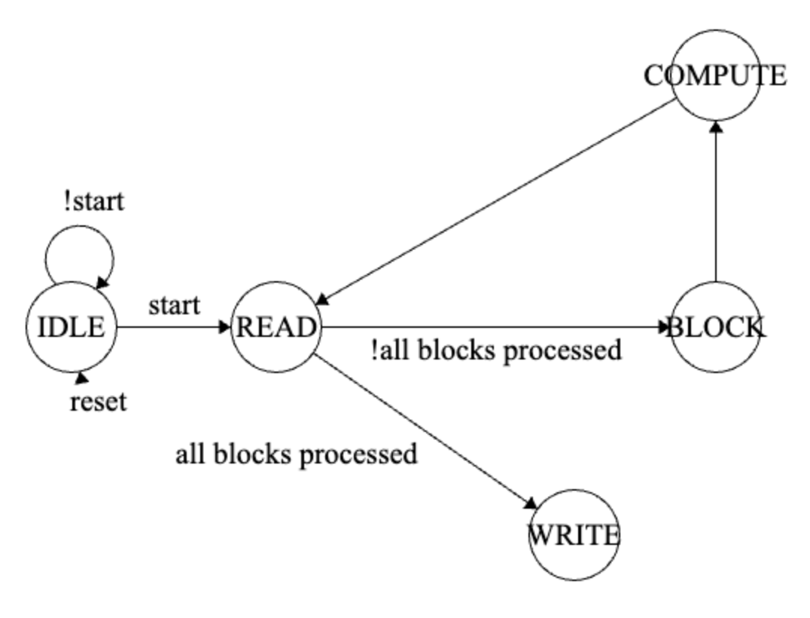
Design Objectives & Constraints
Used FSM to read, compute hash, & write output message
No inferred latches
Target # of cycles, ALUTs, & registers
Notes:
Nick
Our approach and how we transition to each state
Walk through of the different states in our hashing function
Project target values help guide our project’s optimizations and design decisions to have it be as efficient as possible
We will show our project results in the coming slides

Slide 4
Design Challenges
FSM design for the last block that requires padding and the message length
Dealing with inferred latches, having to assign each variable in each state was impossible
Didn’t recognize that all input messages regardless of word count needs to have at least one block containing 32 bits with a leading 1 and the rest of all 0s
Debugging waveform
Notes:
Nick
How we overcame our issues with inferred latches, not getting the correct output, and racing the target number of cycles
Switching from combinational logic to sequential (always_ff) - makes it easier for debugging process with not assigning all variables a value
Using ModelSim waveform to find our code errors and realizing that we always need padding with a leading 1 regardless of the number of words read
The number of cycles were reduced by optimizing word expansion which we will touch upon later

Slide 5
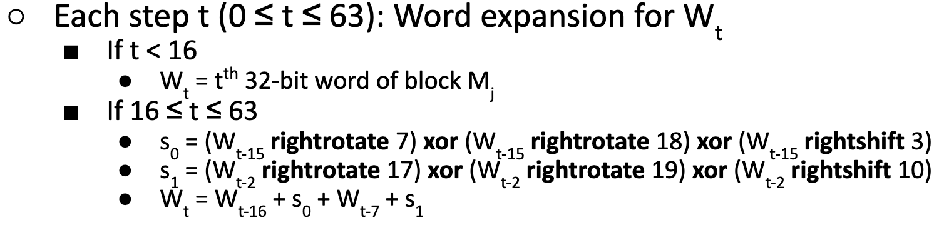
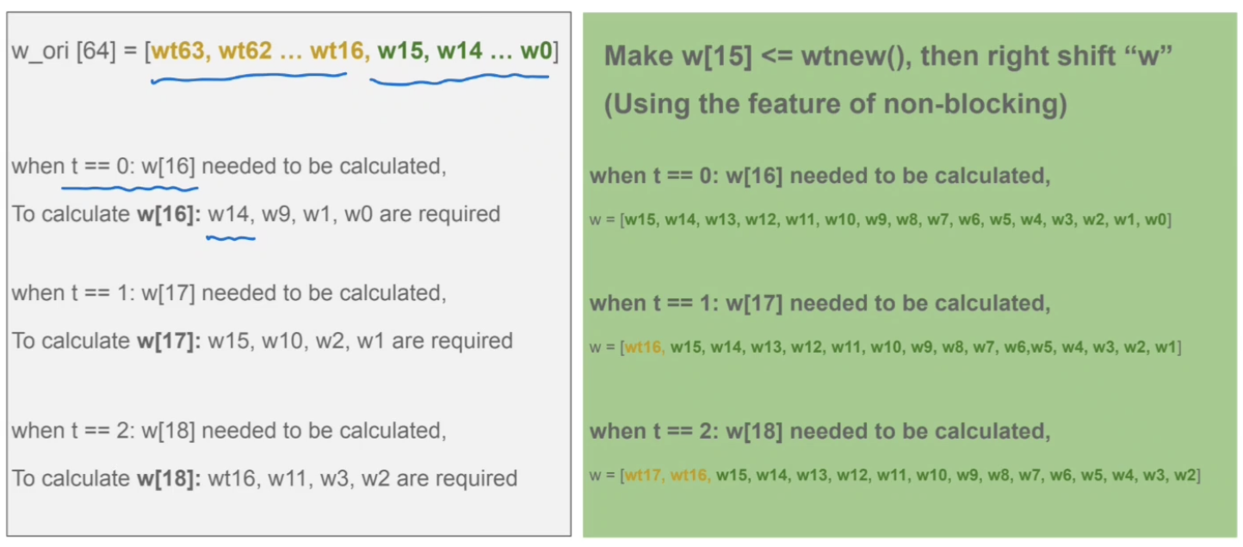
Optimizations
Computing a w value beyond 15 can be done by generating the MSB bit and right shifting
Notes:
Henry
Recognize that the values are w being computed can be done so without storing all 64 values of it
This can be done so by computing the 16th value of w and right shifting its values - basically like a sliding window
Use non-blocking assignments <= to simulate sequential logic since we are using clk
Reduces amount of memory needed to store w from 64 values to 16 and also the number of cycles needed to create new values of w (15 vs 64)

Slide 6
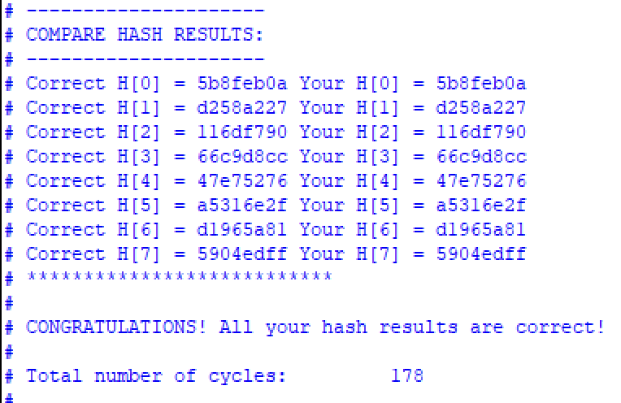
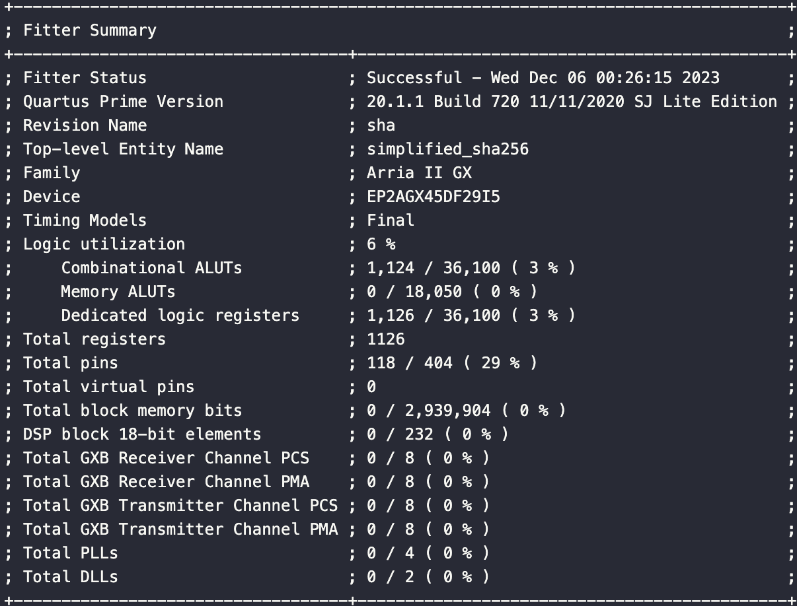
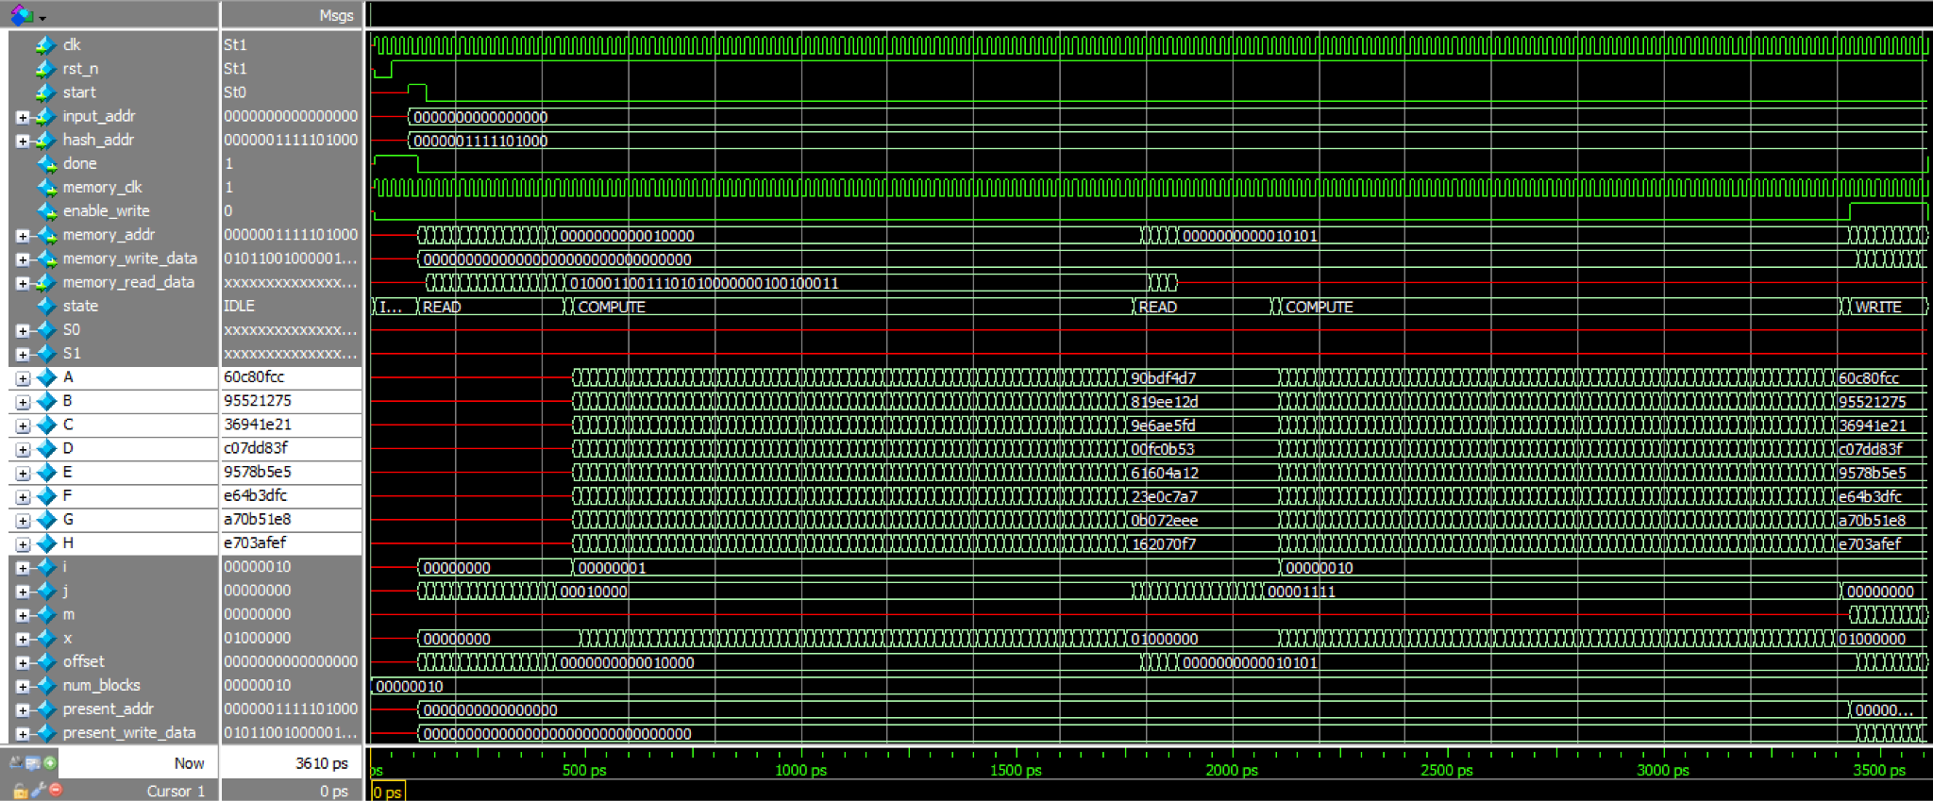
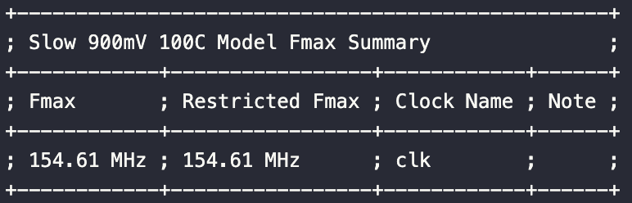
Results
Notes:
Henry
Our SHA256 algorithm used 1,124 ALUTs, 1,126 registers, and a total of 178 cycles when running the testbench with 20 words. All of these fall within reasonable range of the median target values.

Slide 7
Bitcoin Hash
Blockchain technology is the backbone of modern cryptocurrencies
Bitcoin uses SHA-256
Uses a public ledger of transactions, user information, etc.
Blocks linked to each other using hash functions
Blocks are “chained” when hash values meet security requirements
Miners find & compete to find this valid hash
Difficult to corrupt the blockchain
Notes:
Henry
Blockchain technology is a technology commonly used today in cryptocurrencies
It is a decentralized system that uses linked blocks to create a public ledger of transactions, user information, and much more
This information is contained in each block
As well as links to previous blocks
These links to previous blocks are created using hash functions like SHA-256
To place a block onto a blockchain, a hash function meeting difficulty requirements to be generated
This is generated by randomly and repeated generating nonce values in an attempt to create a valid hash function
A nonce value is a completely random string of numbers
Miners compute to perform this hash function
Once difficulty requirements of a hash have been met, the block is added to the chain
Malicious miners trying to corrupt the blockchain face great computational challenges of having to compute all of the previous hash values that link blocks while competing against other miners – making it very computationally difficult for malicious miners to successfully infiltrate the chain

Slide 8
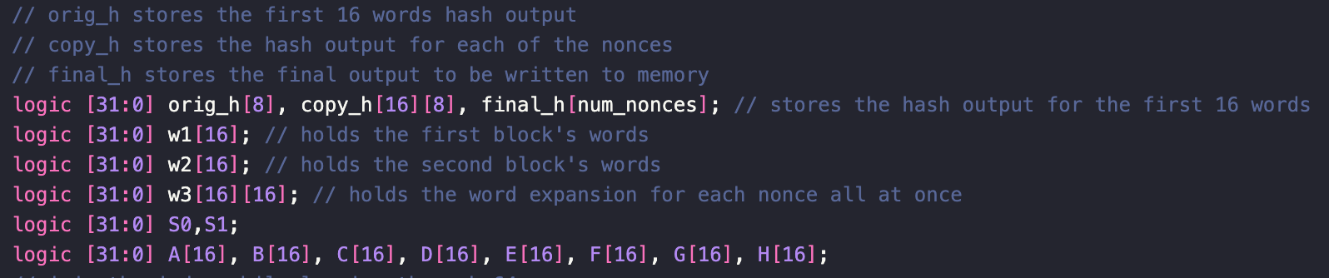
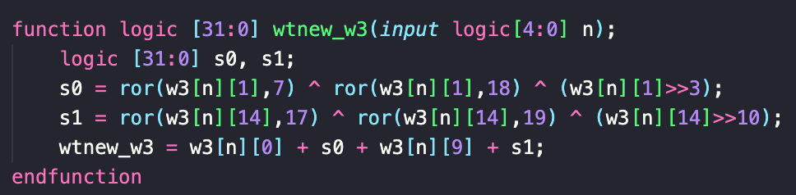
Design Objectives & Constraints
Hash input message for all 16 nonce values
Utilize SHA-256 hash algorithm developed earlier in project
No inferred megafunctions or latches
Notes:
Nick
Our approach and how we transition to each state
Walk through of the different states in our hashing function
Project target values help guide our project’s optimizations and design decisions to have it be as efficient as possible
We will show our project results in the coming slides

Slide 9
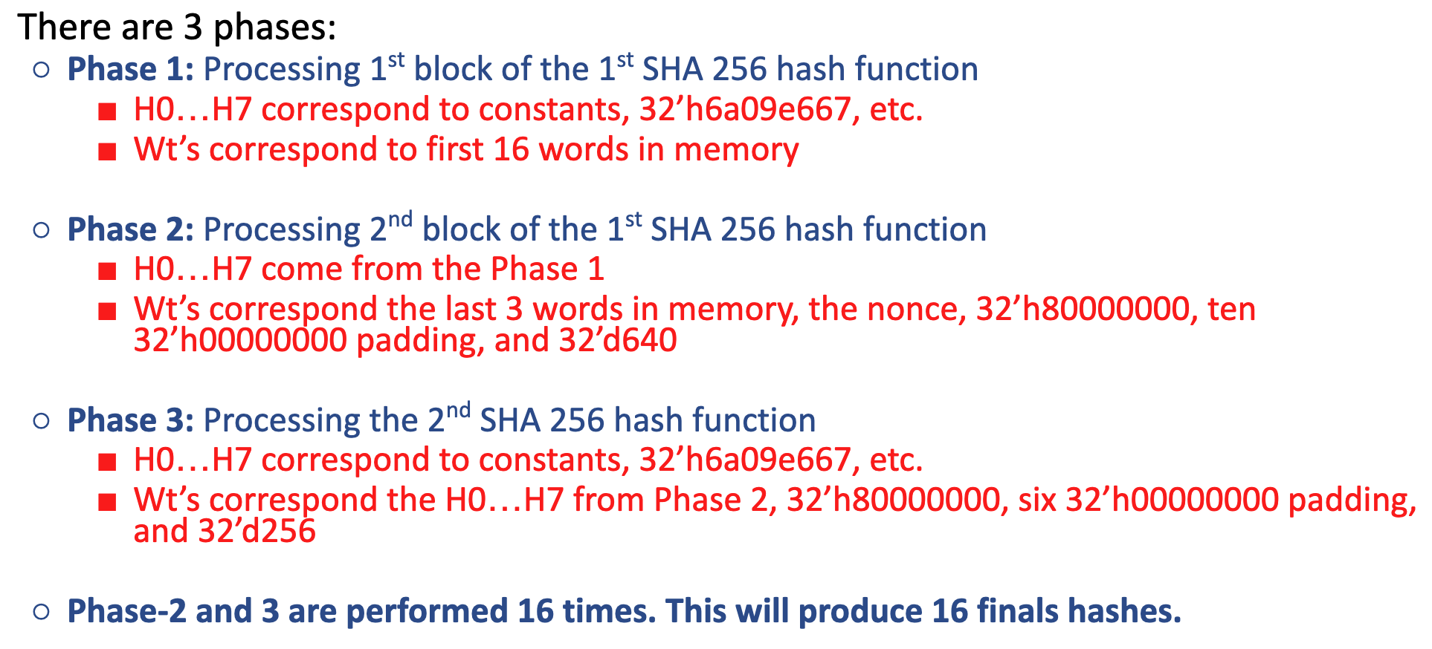
Design Challenges
Didn’t realize that hash values before each SHA256 block in Phase 3 needed to be reset to original constant values
Otherwise was straightforward and an extension of Part 1 of the project
Notes:
Nick

Slide 10
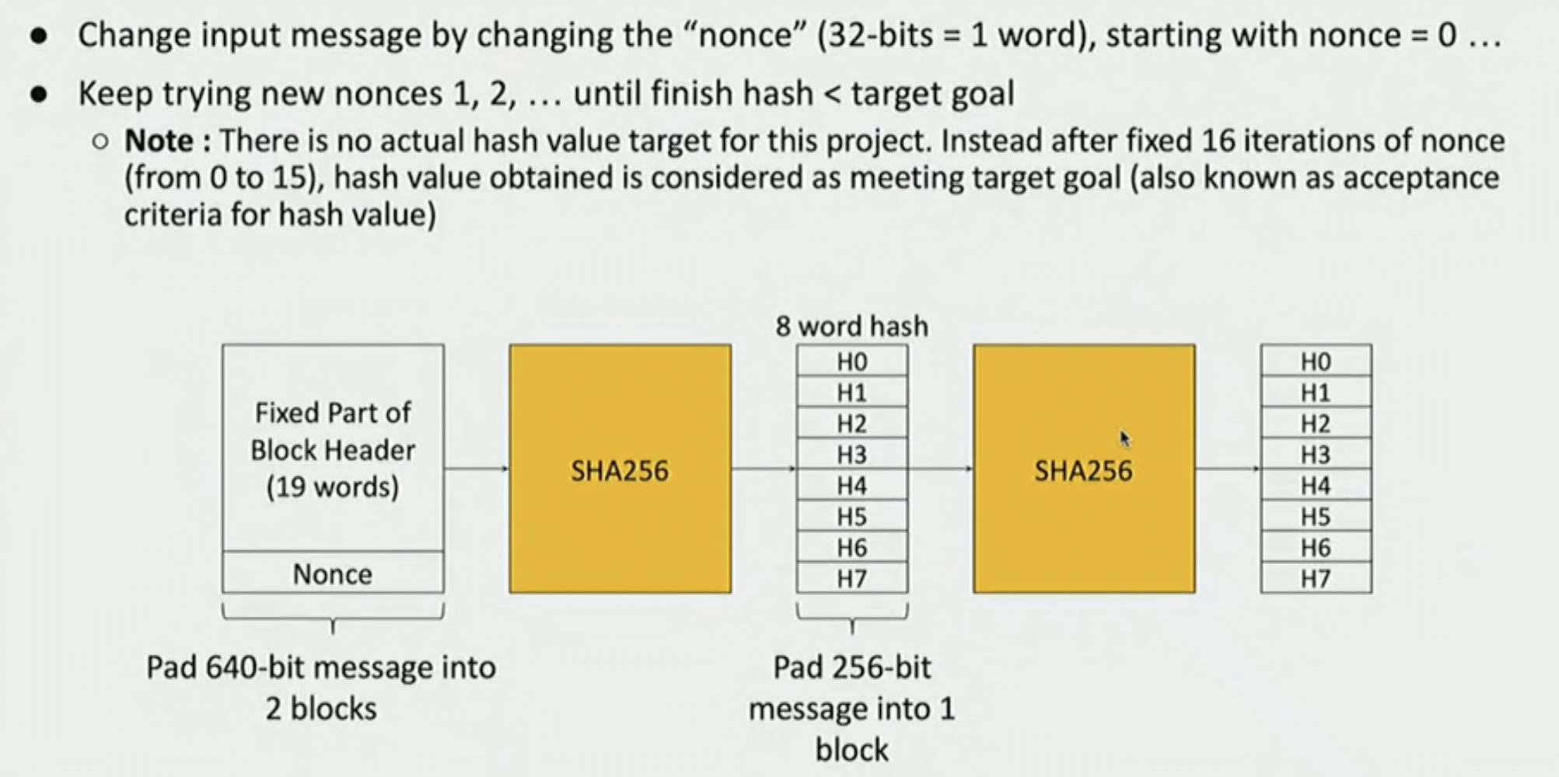
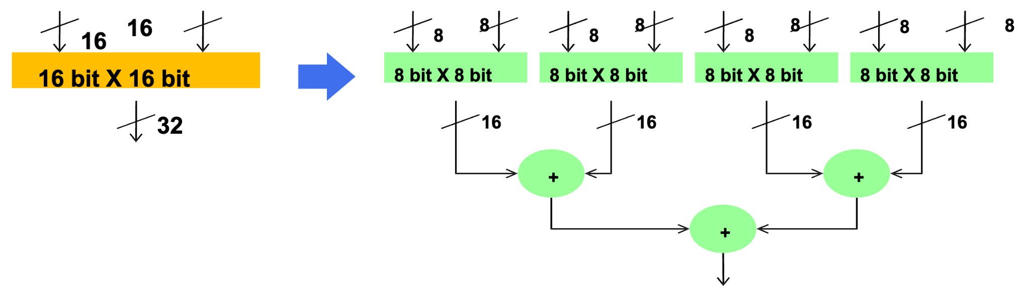
Optimizations
Reusing calculated hash values
Saves 16*64 cycles
Parallelism - in progress
Each nonce relies only on the hash of the first 16 words
Notes:
Henry
An important optimization and realization is that the first 16 words will completely fill 1 block. Computing these hash values will be redundant and only needs to be done once. This optimization can save running 64 rounds of compression for each nonce value.

Slide 11
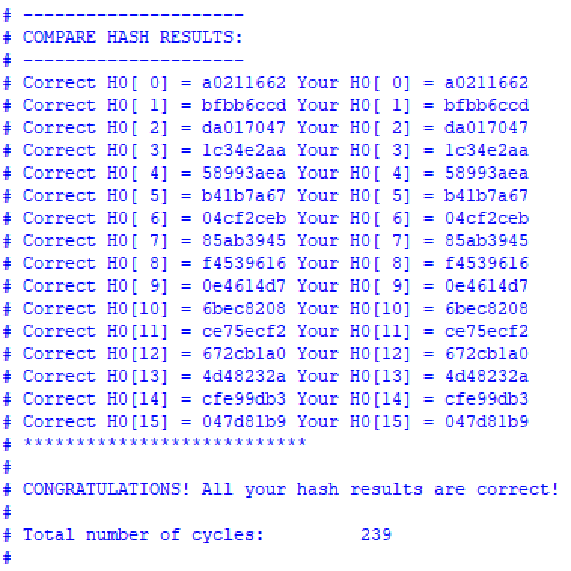
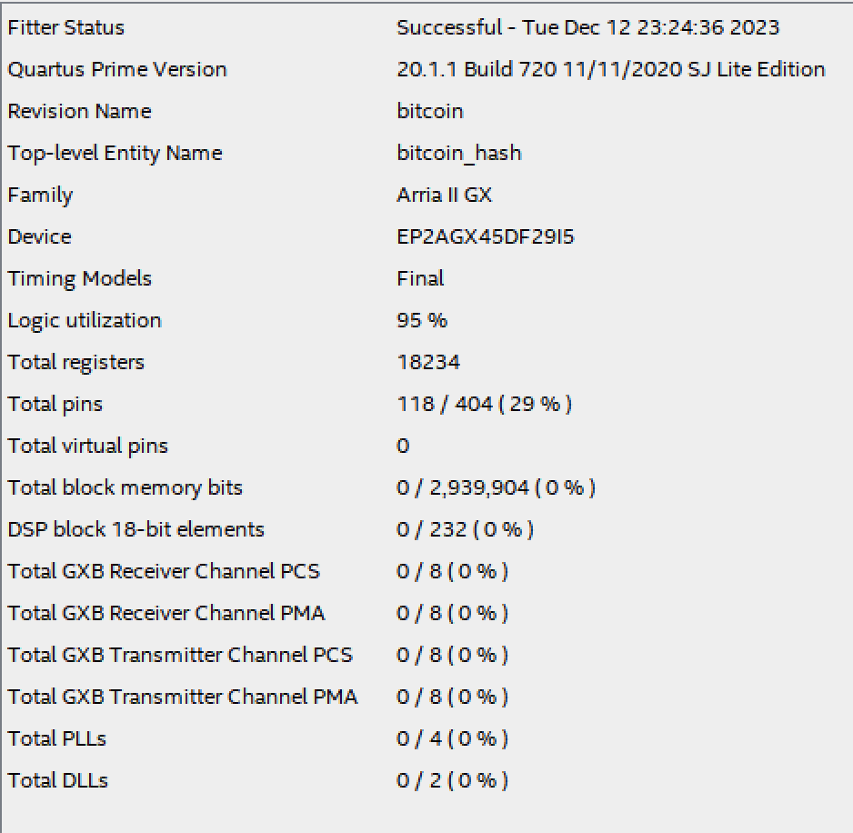
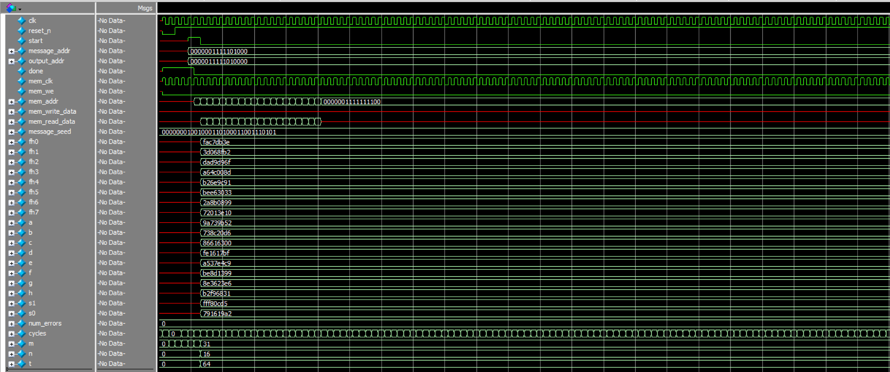
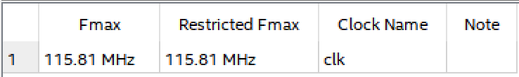
Results
Notes:
Henry
Our SHA256 algorithm used 1,124 ALUTs, 1,126 registers, and a total of 178 cycles when running the testbench with 20 words. All of these fall within reasonable range of the median target values.

Slide 12
Conclusion/ Takeaways
SHA-256 FSM
Completed and Optimized
Lots of practice debugging with modelsim
Deeper understanding of finite state machines
Bitcoin
Understanding of cryptography in modern-day applications
Implementing parallel computation in System Verilog
Notes:
Henry + Nick
For part 1, word expansion can be done by shifting the first 16 bits of w to generate w values beyond 16. Reducing the amount of memory needed to store w and the number of loops needed to create values of w when t is beyond 15.
For part 2, we can recognize that the first 16 words of the input message 19 words will always yield the same hash values. These hash values can then be reused instead of being recomputed for each nonce value.
For part 2, parallelization is another concept that we can take advantage of but that we have yet to implement. This is because nonce values and their hash values only rely on the first 16 words’ hash values and not on previous nonce values’ hashes. This means that nonce hash values can be parallely computed – increasing the speed of creating the final hash values.

